Slide 1
Please do not upload your first homework before 4:30 PM today. I am trying to move its assignment into the correct Homework grading category, and I may need to delete and recreate it to do so.
I will try to write Wednesday’s quiz tonight before I leave for Biskek at 6:00 AM tomorrow. If it is not there, please check at 10:00 AM Wednesday morning, so you can finish it by 10:59 AM.

Slide 2
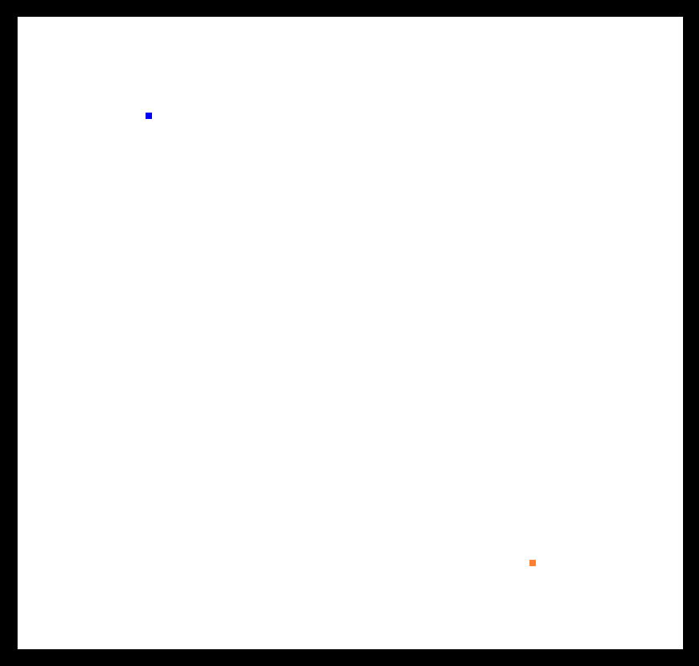
Using rectangles of size 5 by 5, draw orange and blue dots at different positions on the screen.
Download and modify DrawRectangle.html and DrawRectangle.js .

Slide 3
// DrawTwoDots.js (c) 2012 Matsuda, modified to draw two dots by Nelson Max
function main() {
// Retrieve <canvas> element
var canvas = document.getElementById('example');
if (!canvas) {
console.log('Failed to retrieve the <canvas> element');
return false;
}
// Get the rendering context for 2DCG
var ctx = canvas.getContext('2d');
// Draw a blue and an orange dot
ctx.fillStyle = 'rgba(0, 0, 255, 1.0)'; // Set color to blue
ctx.fillRect(120, 10, 1, 1); // Fill a rectangle with the color
ctx.fillStyle = 'rgba(255, 127, 0, 1.0)'; // Set color to orange
ctx.fillRect(200, 90, 1, 1); // Fill a rectangle with the color
}

Slide 4
Using rectangles of size 5 by 5, draw orange and blue dots at different positions on the screen.
Download and modify DrawRectangle.html and DrawRectangle.js .

Slide 5
Conceptual GPU data flow diagram
per-vertex
data
Vertex
Shader
program
Scan conversion
and variable
data interpolation
transformed
per-vertex data
fragments with
per-fragment data
texel address
Fragment
Shader
program
Texture
Memory
texel
data
Bilinear
texture
interpolation
data from
4 texels
pixel address
Active
Frame
Buffer
RGBA color
RGBA
Compositing
and
Depth Test
depth
depth
Depth
Buffer

Slide 6
Scan converting a triangle means finding its fragments, namely the pixel centers inside it.
For proper transparency of a surface made from adjacent triangles, a pixel center exactly on the edge between two triangles should be a fragment in only one of them. To do this say:
A right edge has the triangle interior to its left.
A left edge has the triangle interior to its right.
Then make fragments for pixel centers exactly on an edge only if the edge is a left edge.
For pixel centers exactly on a horizonal edge, make fragments only if the edge is a top edge.
B
left
edge
A
right
edge
left
edge
C

Slide 7
Scan converting a triangle means finding its fragments, namely the pixel centers inside it.
right
edge
Edge AB is a left edge of triangle ABC, but a right edge of adjacent triangle ABD, so pixels with centers exactly on edge AB will be fragments only for triangle ABC.
For floating point vertex coordinates, as in a perspective projection, it is unlikely that any pixel center will be directly on an edge, but for 2D drawings, this is more likely.
D
B
left
edge
right
edge
left
edge
A
right
edge
left
edge
C

Slide 8
To make coding easier, divide each triangle into two pieces, each with a horizontal edge.
right
edge
D
B
left
edge
right
edge
left
edge
A
right
edge
left
edge
C

Slide 9
To make coding easier, divide each triangle into two pieces, each with a horizontal edge.
Sort the vertices by their Y coordinates in top to bottom order, and call them Ptop, Pmiddle, and Pbottom, with
Ptop = (xtop, ytop)
Pmiddle = (xmiddle, ymiddle)
Pbottom = (xbottom, ybottom).
So ytop >= ymiddle >= ybottom.
Ptop
Pmiddle
Pbottom

Slide 10
To make coding easier, divide each triangle into two pieces, each with a horizontal edge.
Sort the vertices by their Y coordinates top to bottom order, and call them Ptop, Pmiddle, and Pbottom, with
Ptop = (xtop, ytop)
Pmiddle = (xmiddle, ymiddle)
Pbottom = (xbottom, ybottom).
Draw a horizontal line though Pmiddle, which intersects edge Ptop Pbottom at Qmiddle.
Ptop
Qmiddle
Pmiddle
Pbottom

Slide 11
To make coding easier, divide each triangle into two pieces, each with a horizontal edge.
Sort the vertices by their Y coordinates top to bottom order, and call them Ptop, Pmiddle, and Pbottom, with
Ptop = (xtop, ytop)
Pmiddle = (xmiddle, ymiddle)
Pbottom = (xbottom, ybottom).
Draw a horizontal line though Pmiddle, which intersects edge Ptop Pbottom at Qmiddle.
Ptop
Pmiddle
Qmiddle
Pbottom

Slide 12
To make coding easier, divide each triangle into two pieces, each with a horizontal edge.
Sort the vertices by their Y coordinates top to bottom order, and call them Ptop, Pmiddle, and Pbottom, with
Ptop = (xtop, ytop)
Pmiddle = (xmiddle, ymiddle)
Pbottom = (xbottom, ybottom).
If the triangle already had a horizontal edge, then there is no need to divide it in two.
Ptop
Pmiddle
Pbottom

Slide 13
Each piece has one left edge, one right edge, and one horizontal edge.
right
edge
left
edge
horizontal
edge
horizontal
edge
left
edge
right
edge

Slide 14
Each piece has one left edge, one right edge, and one horizontal edge.
right
edge
For each piece, find the line equation for x in terms of y, by a version of the two-point equation.
You may have used such an equation for draw_line_y() in Homework 1.
left
edge
horizontal
edge
horizontal
edge
left
edge
right
edge

Slide 15
Two-point equation for a line through points P1 = (x1, y1) and P2 = (x2, y2): solve for x in terms of y, instead of y in terms of x as was done below.
Y
y – y1 y2 – y1
x – x1 x2 – x1
y – y1 = (x – x1)
y = x + y1 – x1
y = m x + b
=
y2
P2 = (x2, y2)
y
P = (x, y)
y2 – y1
x2 – x1
y1
B
y2 – y1
x2 – x1
y2 – y1
x2 – x1
P1 = (x1, y1)
A
b
X
x1
x
x2
slope
Y intercept

Slide 16
Each piece has one left edge, one right edge, and one horizontal edge.
right
edge
For each piece, find the line equation for x in terms of y, by a version of the two-point equation.
You may have used such an equation for draw_line_y() in Homework 1.
For use in a later slide with code, let the two equations be:
xleft = f_left(y) and
xright = f_right(y)
left
edge
horizontal
edge
horizontal
edge
left
edge
right
edge

Slide 17
Find pixel centers inside the triangle, or on its left or top edges.
Y
Pixel edges are at integer positions, and pixels are named by their lower left corners (i, j). Pixel centers are at (i + .5, j + .5).
Select pixels whose centers are in the interior of the triangle.
X

Slide 18
Find pixel centers inside the triangle, or on its left or top edges.
Y
Pixel edges are at integer positions, and pixels are named by their lower left corners (i, j). Pixel centers are at (i + .5, j + .5).
Select pixels whose centers are in the interior of the triangle.
X

Slide 19
Find pixel centers inside the triangle, or on its left or top edges.
Y
Pixel edges are at integer positions, and pixels are named by their lower left corners (i, j). Pixel centers are at (i + .5, j + .5).
Select pixels whose centers are in the interior of the triangle.
Then add pixels that are on left or top edges.
X

Slide 20
Find pixel centers inside the triangle, or on its left and top edges.
Y
Pixel edges are at integer positions, and pixels are named by their lower left corners (i, j). Pixel centers are at (i + .5, j + .5).
Select pixels whose centers are in the interior of the triangle.
Then add pixels that are on left or top edges.
X

Slide 21
Find pixel centers inside this adjacent triangle, or on its left or top edges.
Y
Pixel edges are at integer positions, and pixels are named by their lower left corners (i, j). Pixel centers are at (i + .5, j + .5).
Select pixels whose centers are in the interior of the triangle.
X

Slide 22
Find pixel centers inside this adjacent triangle, or on its left or top edges.
Y
Pixel edges are at integer positions, and pixels are named by their lower left corners (i, j). Pixel centers are at (i + .5, j + .5).
Select pixels whose centers are in the interior of the triangle.
X

Slide 23
Find pixel centers inside this adjacent triangle, or on its left or top edges.
Y
Pixel edges are at integer positions, and pixels are named by their lower left corners (i, j). Pixel centers are at (i + .5, j + .5).
Select pixels whose centers are in the interior of the triangle.
Then add pixels that are on left or top edges.
X

Slide 24
Find pixel centers inside this adjacent triangle, or on its left or top edges.
Y
Pixel edges are at integer positions, and pixels are named by their lower left corners (i, j). Pixel centers are at (i + .5, j + .5).
Select pixels whose centers are in the interior of the triangle.
Then add pixels that are on left or top edges.
Note that the right-hand pixel on the top edge is not added because it is on a right edge.
X

Slide 25
Find pixel centers inside this adjacent triangle, or on its left or top edges.
Y
Pixel edges are at integer positions, and pixels are named by their lower left corners (i, j). Pixel centers are at (i + .5, j + .5).
Select pixels whose centers are in the interior of the triangle.
X

Slide 26
Find pixel centers inside this adjacent triangle, or on its left or top edges.
Y
Pixel edges are at integer positions, and pixels are named by their lower left corners (i, j). Pixel centers are at (i + .5, j + .5).
X

Slide 27
Find pixel centers inside this adjacent triangle, or on its left or top edges.
Y
Pixel edges are at integer positions, and pixels are named by their lower left corners (i, j). Pixel centers are at (i + .5, j + .5).
Select pixels whose centers are in the interior of the triangle.
Then add pixels that are on left or top edges.
X

Slide 28
Find pixel centers inside this adjacent triangle, or on its left or top edges.
Y
Pixel edges are at integer positions, and pixels are named by their lower left corners (i, j). Pixel centers are at (i + .5, j + .5).
Select pixels whose centers are in the interior of the triangle.
Then add pixels that are on left or top edges.
Note that the bottom pixel on the left edge is not added because it is on a bottom edge.
X

Slide 29
Find pixel centers inside this adjacent triangle, or on its left or top edges.
Y
Pixel edges are at integer positions, and pixels are named by their lower left corners (i, j). Pixel centers are at (i + .5, j + .5).
Select pixels whose centers are in the interior of the triangle.
X

Slide 30
Find pixel centers inside this adjacent triangle, or on its left or top edges.
Y
Pixel edges are at integer positions, and pixels are named by their lower left corners (i, j). Pixel centers are at (i + .5, j + .5).
Select pixels whose centers are in the interior of the triangle.
X

Slide 31
Find pixel centers inside this adjacent triangle, or on its left or top edges.
Y
Pixel edges are at integer positions, and pixels are named by their lower left corners (i, j). Pixel centers are at (i + .5, j + .5).
Select pixels whose centers are in the interior of the triangle.
Then add pixels that are on left or top edges.
X

Slide 32
Find pixel centers inside this adjacent triangle, or on its left or top edges.
Y
Pixel edges are at integer positions, and pixels are named by their lower left corners (i, j). Pixel centers are at (i + .5, j + .5).
Select pixels whose centers are in the interior of the triangle.
Then add pixels that are on left or top edges.
Note that the right pixel on the top edge is not added because it is on a right edge.
X

Slide 33
Five triangles to scan convert for homework. I added triangle
ADG so that there would be one to divide in two.
B
E
D
C
A
G
F

Slide 34
// Describing triangles by vertex indices
int triangles[5][3] = {
{0, 1, 2}, // ABC
{0, 3, 1}, // ADB
{1, 4, 2}, // BEC
{0, 2, 5}, // ACF
{0, 3, 6} // ADG
};
double vertices[8][2] = {
{74.5, 175.5}, // A
{224.5, 325.5}, // B
{374.5, 175.5}, // C
{74.5, 325.5}, // D
{374.5, 325.5}, // E
{150., 100.}, // F
{ 25., 125.}, // G
{0., 0.} // Q, other vertex on the horizontal cutting line
};

Slide 35
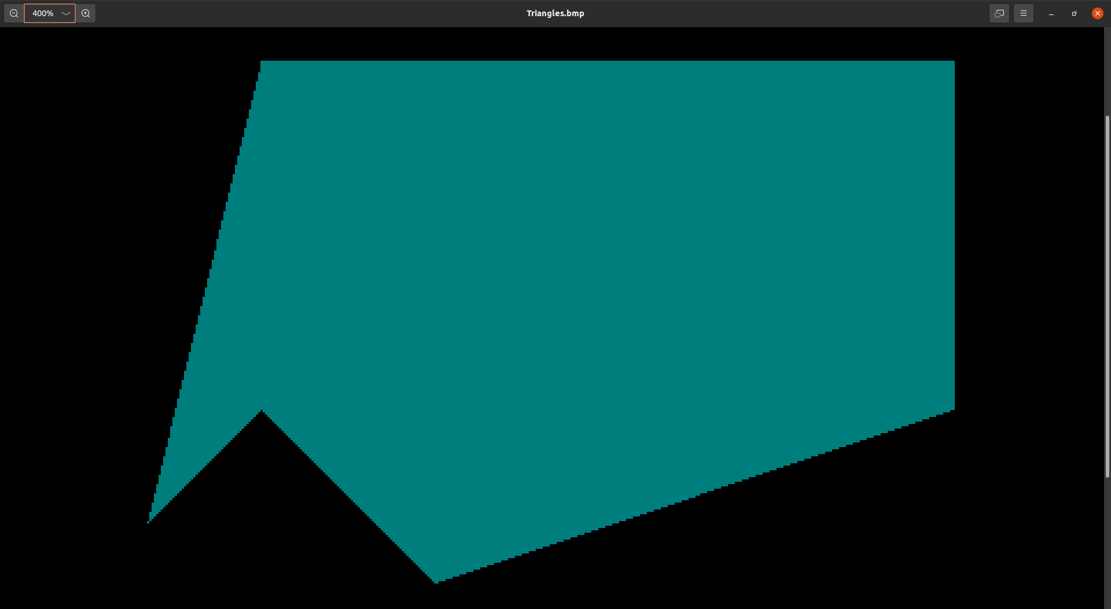
for (y = i_top + .5; y > bottom_y; y -= 1) {
for (x = i_left + .5; x < xright; x += 1) {

Slide 36

for (y = i_top + .5; y >= bottom_y; y -= 1) {
for (x = i_left + .5; x <= xright; x += 1) {

Slide 37
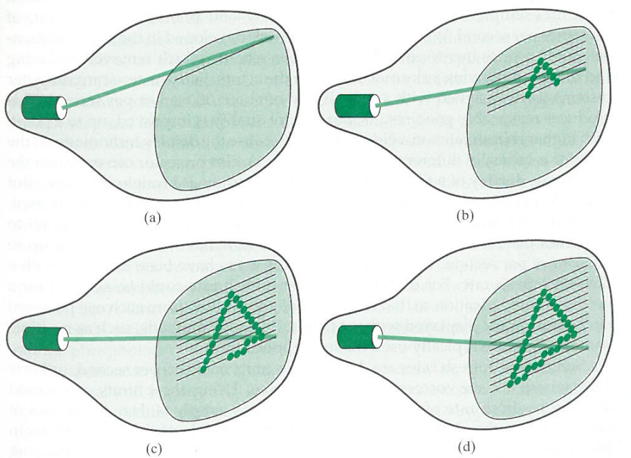
Raster image

Slide 38
Because CRT raster scans were one scan line at a time, from top to bottom, and from left to right on each scan line, it is traditional to scan convert polygons that way.

Slide 39
Let top_y be the y coordinate of the top vertex, and let bottom_y be the y coordinate of the bottom vertex.
Y
top_y
bottom_y
X

Slide 40
Let top_y be the y coordinate of the top vertex, and let bottom_y be the y coordinate of the bottom vertex.
To find which blue scan lines through pixel centers can have fragments in the triangle find the largest integer i_top so that
i_top + .5 <= top_y
i_top <= top_y - .5
so
i_top = floor(top_y - .5)
Y
top_y
bottom_y
X

Slide 41
Let top_y be the y coordinate of the top vertex, and let bottom_y be the y coordinate of the bottom vertex.
To find which blue scan lines through pixel centers can have fragments in the triangle find the largest integer i_top so that
i_top + .5 <= top_y
i_top <= top_y - .5
so
i_top = floor(top_y - .5)
Y
top_y
i_top + .5
i_top
bottom_y
X

Slide 42
Y
Fragments are not generated by pixel centers exactly on bottom edges, so the loop over scan lines y is:
for (y = i_top + .5; y > bottom_y; y = y-1) {
top_y
i_top + .5
i_top
bottom_y
X

Slide 43
Y
Fragments are not generated by pixel centers exactly on bottom edges, so the loop over scan lines y is:
for (y = i_top + .5; y > bottom_y; y = y-1) {
To find the x range for fragments along scan line y, use the equations xleft = f_left(y) and xright = f_right(y).
To find the x coordinate i_left of the first pixel on scan line y, use
i_left + .5 >= xleft
i_left >= xleft - .5
so
i_left = ceil(xleft - .5)
top_y
i_top + .5
i_top
y
bottom_y
X
xleft
xright

Slide 44
Y
Fragments are not generated by pixel centers exactly on bottom edges, so the loop over scan lines y is:
for (y = i_top + .5; y > bottom_y; y = y-1) {
To find the x range for fragments along scan line y, use the equations xleft = f_left(y) and xright = f_right(y).
To find the x coordinate i_left of the first pixel on scan line y, use
i_left + .5 >= xleft
i_left >= xleft - .5
so
i_left = ceil(xleft - .5)
top_y
i_top + .5
i_top
y
bottom_y
X
xleft
i_left
xright

Slide 45
Y
Fragments are not generated by pixel centers exactly on bottom edges, so the loop over scan lines y is:
for (y = i_top + .5; y > bottom_y; y = y - 1) {
Fragments are not generated by pixel centers exactly on right edges, so the loop over x in scan line y is:
for (x = i_left + .5; x < xright; x = x - 1) {
top_y
i_top + .5
i_top
y
bottom_y
X
xleft
i_left
xright

Slide 46
Summary: C/C++ code to generate the fragments
i_top = floor(top_y - .5);
for (y = i_top + .5; y > bottom_y; y = y - 1) {
xleft = f_left(y);
xright = f_right(y);
i_left = ceil(xleft - .5);
for (x = i_left + .5; x < xright; x = x + 1) {
set_pixel_alpha((int)floor(x), (int)floor(y), r, g, b, a);
}
}
// This works for the horizontal edge on the top or the bottom.

Slide 47
Scissoring to avoid generating off-screen fragments
i_top = floor(top_y - .5);
for (y = i_top + .5; y > bottom_y; y = y - 1) {
xleft = f_left(y);
xright = f_right(y);
i_left = ceil(xleft - .5);
for (x = i_left + .5; x < xright; x = x + 1) {
if (x >= 0 && x < width && y >= 0 && y < height)
set_pixel_alpha((int)floor(x), (int)floor(y), r, g, b, a);
}
}
// This works for the horizontal edge on the top or the bottom.

Slide 48
Clipping to avoid generating off-screen fragments
i_top = floor(top_y - .5);
if (itop > height – 1) i_top = height – 1;
if (bottom_y < 0) bottom_y = 0;
for (y = i_top + .5; y > bottom_y; y = y - 1) {
xleft = f_left(y);
xright = f_right(y);
i_left = ceil(xleft - .5);
if (i_left < 0) i_left = 0;
if (xright > width) xright = width;
for (x = i_left + .5; x < xright; x = x + 1)
set_pixel_alpha((int)floor(x), (int)floor(y), r, g, b, a);
}

Slide 49
Clipping to avoid generating off-screen fragments
Replace this triangle
screen window

Slide 50
Clipping to avoid generating off-screen fragments
Replace this triangle by
this more complicated
polygon.
screen window

Slide 51
Clipping to avoid generating off-screen fragments
Replace this triangle by
this more complicated
polygon, and divide it
into triangles.
screen window

Slide 52
Clipping to avoid generating off-screen fragments
Replace this triangle by
this more complicated
polygon, and divide it
into triangles. Then
scan convert the triangles.
screen window

Slide 53
Clipping to avoid generating off-screen fragments
Replace this triangle by
this more complicated
polygon. Alternatively,
divide the polygon by
horizontal lines into
pieces with a single left
edge and a single right
edge, and scan convert
the pieces by the above
algorithm.
screen window

Slide 54
Class exercise
Draw a quarter circle without antialiasing using a 2d HTML canvas, by converting my Line_x.cpp to JavaScript. Instead of calling set_pixel(x, y, r, g, b) call ctx.fillRect(x, y, 1, 1). Be sure to first call ctx.fillStyle = 'rgba(0, 0, 255, 1.0)’ outside the loop over the n line segments in main() to set the color to blue. This is mainly an exercise about the differences between C/C++ and JavaScript. It does not use WebGL.
I said to use my Line_x.cpp rather than your own Line.cpp if you have completed it, in order to let you help each other in this exercise, without revealing your homework solutions.

